Slide 1
South Billings Boulevard Capital Improvement Plan
FY24-28

Slide 2
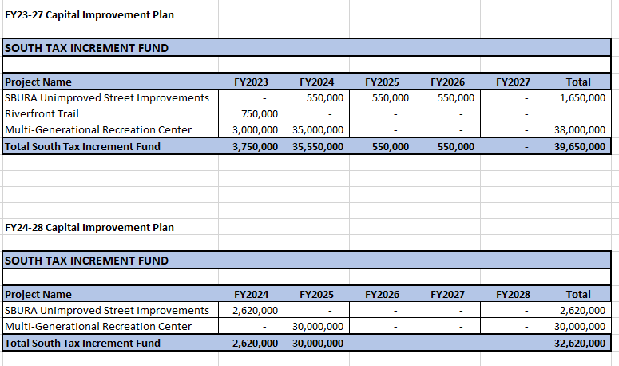
South Billings Boulevard Capital Improvement Plan
FY24-28

Slide 3
Unimproved Roads

Slide 4
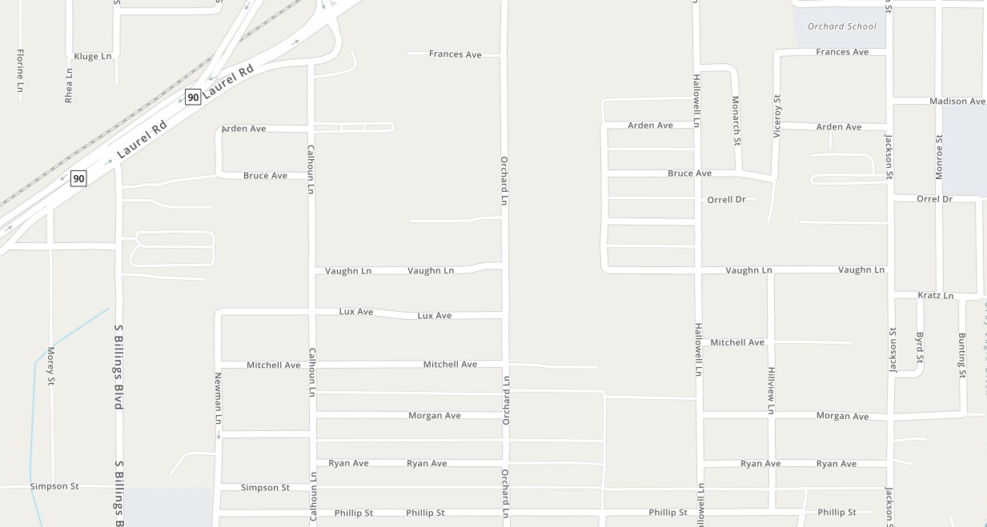
$441k
South Billings Urban Renewal District
Unimproved Roads-North
Completed
Remaining
FY24 CIP
Optimist Park

Slide 5
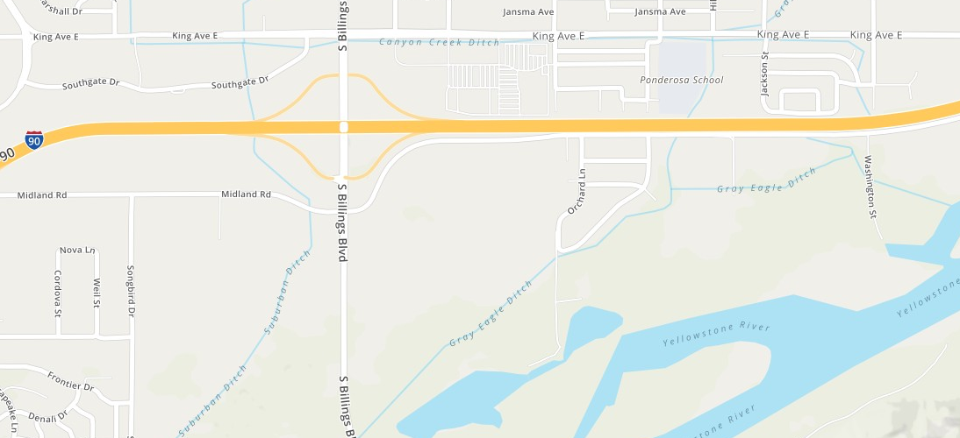
South Billings Urban Renewal District
Unimproved Roads-South
Remaining

Slide 6
Discussion

